Slide 1
Kidney A1
Meeting minutes &
Action point slides
Date: 1/5/2022(Week 9)

Slide 2
Progress and action points
Action points from last week … …
We each worked on different datasets containing similar clinical variables to build models.
Key progress over last week …
The GSE46474 dataset was cleaned, the first 20 genes were taken, pre-validation was done, and the logistic model was trained, but the logistic model could not do CV because there were multiple variables found in the dataset, so the model was simply ran. (Xuening Ni)
Find common top genes in 3 datasets using differential expressions, build a model on GSE1563 using these genes, age & gender and test it on GSE51675 & GSE46474. (Qinlin Gu)
Take the top 100 genes and AR/non-AR characters from GSE138043 to build model, get the CV accuracy and make a plot. (Danying SUN)

Slide 3
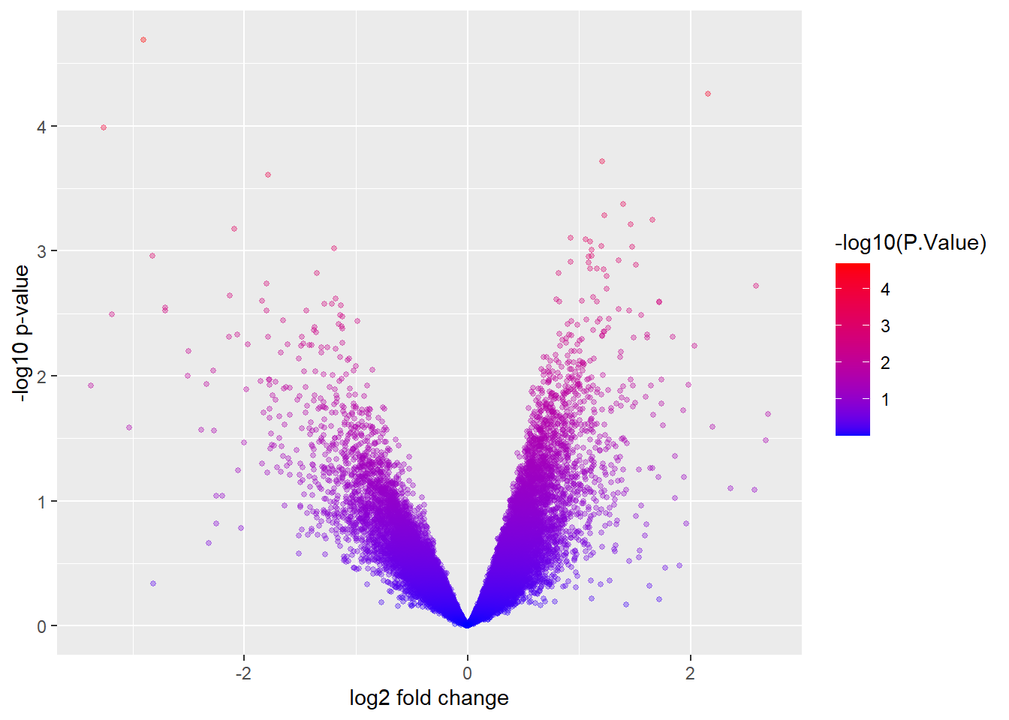
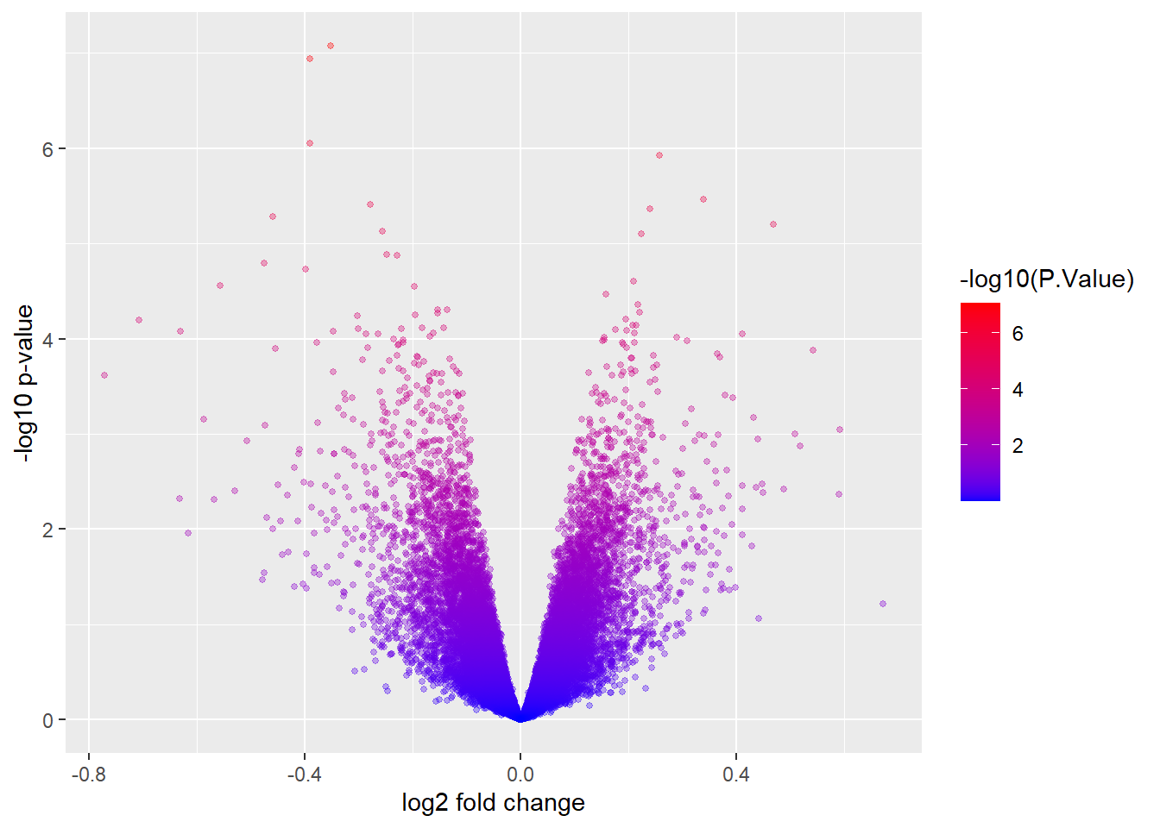
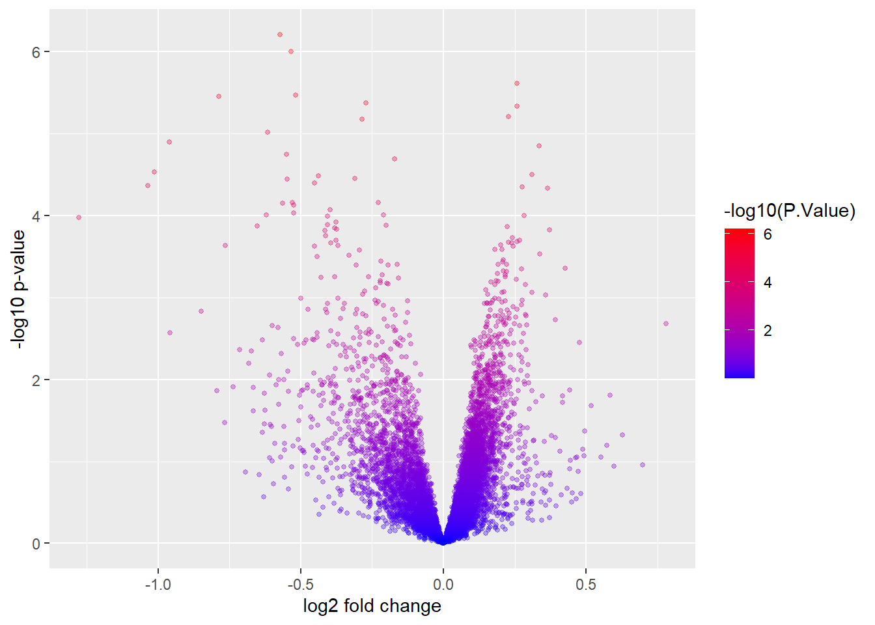
Developing the project – data
Illustrate progress in data generation or data collection by showing some initial data analysis of your data.

Slide 4
Developing the project – methods
Proposed analytics or proposed methods.
Use differential expressions to top genes from 3 datasets
Find the intersection of these top genes
Use top genes, gender and age to build a model on one of the datasets
Test the model using CV on the training dataset
Test the model on the other 2 independent datasets
Models using prevalidation techniques were difficult to be tested on independent datasets.

Slide 5
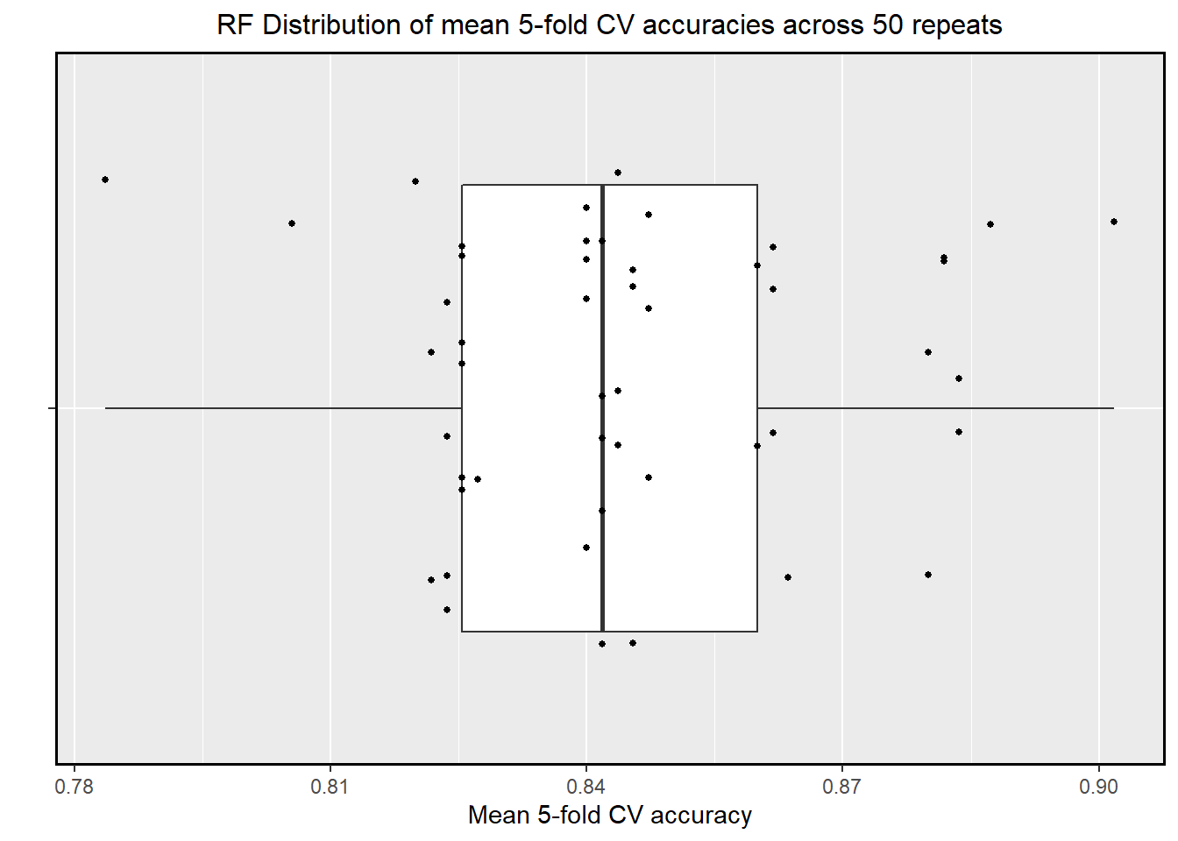
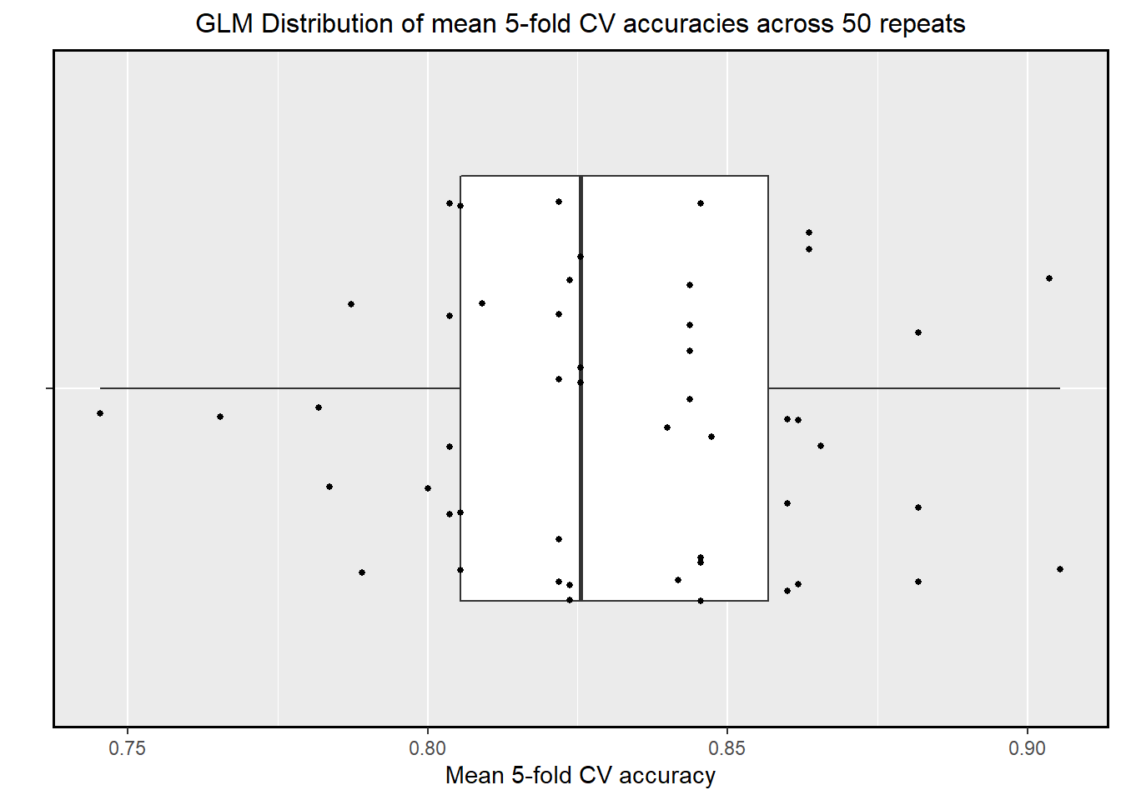
Developing the project – initial evaluation
At least one figure showing the evaluation result

Slide 6
Meeting minutes
Date and time of meeting: 01/05/2022
Team members present: Qinlin Gu, Danying Sun, Xuening Ni, Hangyi Wu, Yuye Zhou
AGENDA
Item | Discussion (you can refer to previous slides) | Actions (who) – action points for next week
Future plans |  | Finalizing models and writing reports in week 10 & 11 Building shiny app in week 12 & 13
 |  | Is there a demonstration? And when will it be?
Next meeting date and time: 08/05/2022
Group member responsible for finalising/submitting minutes: Danying Sun
To be posted on the CANVAS Individual group website

